Slide 1
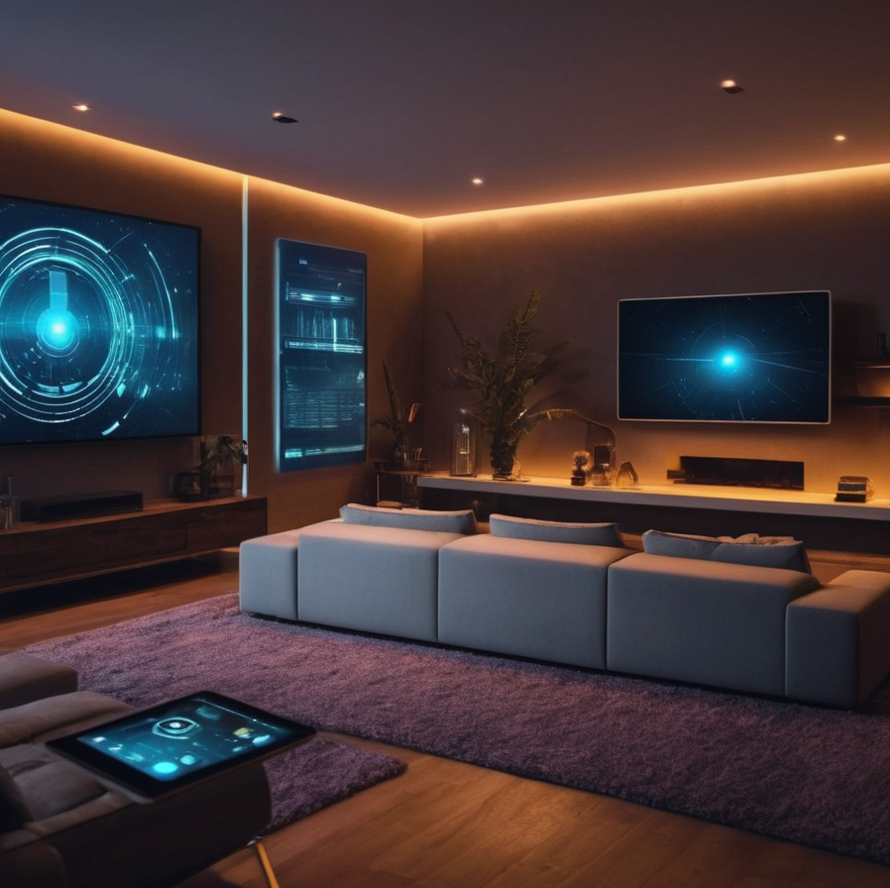
Innovative Home Automation for Energy Efficiency
Team Members: George Warda, Samuel Azzawi, Linus Lorensson
University/Department: Linnaeus University, Software Engineering Department

Slide 2

Background
Our purpose
To develop a home automation system that optimizes energy usage, particularly in lighting, to achieve significant energy savings.
The problem
Many households consume excess electricity due to inefficient lighting usage. Our project aims to tackle this issue through smart automation.

Slide 3

Requirements
Requirements were established based on energy-saving goals and user-friendly interaction.
Turning a light on/off based on light levels.
Presenting the data graph for lighting history.
Schedule system for light.

Slide 4
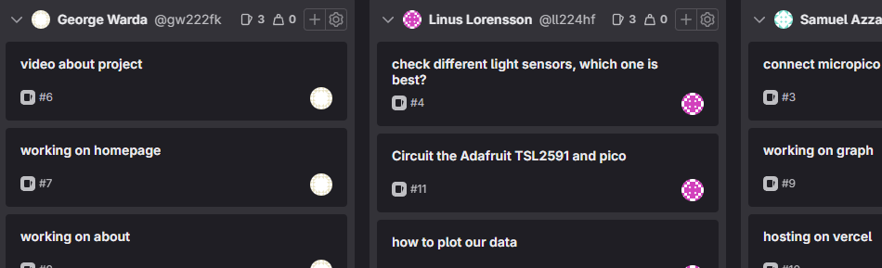
Planning and execution
We utilized GitLab for version control, ensuring smooth collaboration and progress tracking.
Our project management was streamlined using GitLab's Boards and Issues.

Slide 5

Testing
Our testing approach included unit testing for individual components and integration testing for the overall system functionality.
For instance, we tested the light sensitivity module's response to varying light conditions.

Slide 6
Result
The final system effectively controls lighting based on ambient light and scheduled preferences, demonstrating potential energy savings.

Slide 7



Discussion and Conclusion
This project challenged us to apply our theoretical knowledge in a practical setting, enhancing our problem-solving skills.
One key lesson was the importance of regular testing and iteration. We also learned the value of effective team communication.

Slide 8

Teamwork and timelog
Tasks were evenly distributed, with regular meetings to ensure everyone was on track and to discuss any challenges.
Linus focused on hardware integration, Samuel on backend development, and George on frontend design and user experience.

